Slide 1
Placement Preparation App
-Tech Gita Warriors

Slide 2
Tech Gita Warriors
Members
Bhavya gupta (team lead)
Nishika
Vikash
Rachit

Slide 3

Deviathon
Date: 9-11oct
Gla University Mathura

Slide 4
Hackathon Problem
To develop a Placement Preparation App tailored for GLA University students to assist in preparing for campus placements effectively.

Slide 5
Problem area
Lack of centralized preparation platform
Difficulty in tracking company-specific preparation material
Mock test or real-time performance analysis
Scattered resources and inconsistent mentorship

Slide 6
Objectives
Create a centralized hub for placement prep
Offer company-specific preparation modules
Daily quizzes and mock tests
Track progress and suggest improvements
Community support and mentor integration

Slide 7
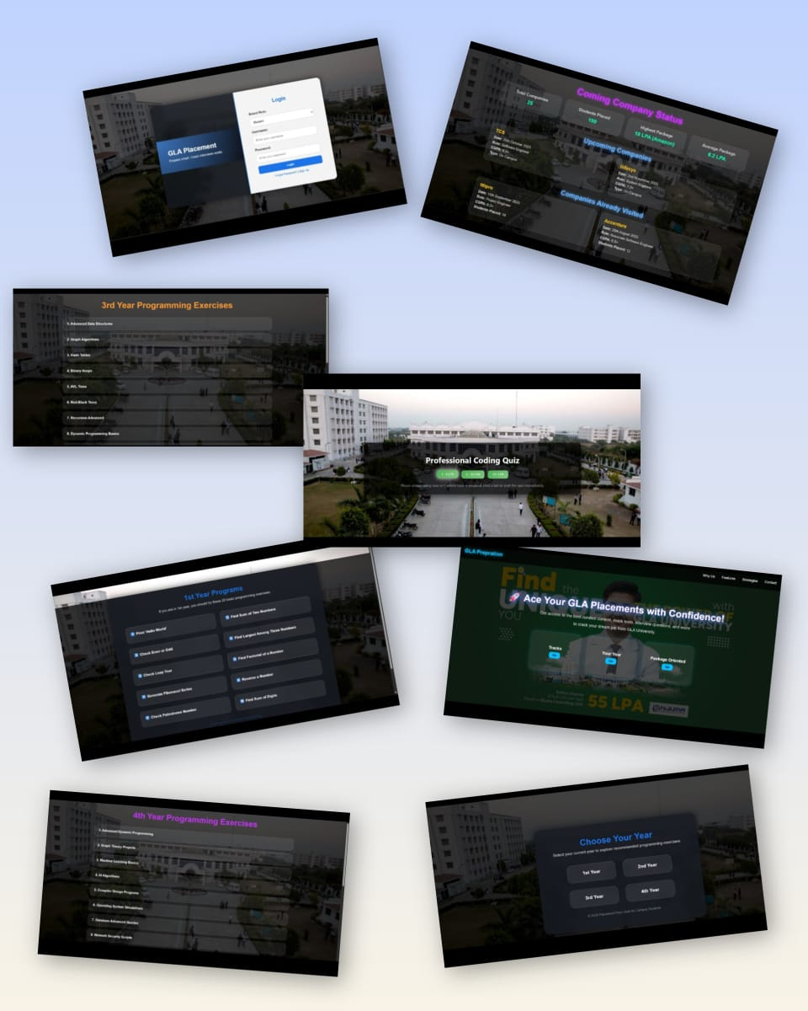
Project insights
Login page (as admin/student)
Track selection page
Placement oriented Questions
Year selection

Slide 8
Tech Stack
Frontend: HTML, CSS, JavaScript
Backend: Express.js
Database: My SQL
Deployment: Vercel (github)

Slide 9
Target Users
Primary Audience: GLA University Students (1st,2nd, 3rd, and 4th year)
Secondary Audience: Placement Cell, Alumni, and Mentors

Slide 10
Features
MCQ practice by topics
Interview preparation tips
Mock tests with analysis
Resume builder
Notifications for upcoming drives
DSA companies top 100 Question

Slide 11
Key Features
Aptitude Prep: Quants, Logical, Verbal with quizzes
Coding Section: Topic-wise practice, compiler, company tags
Interview Prep: HR and Tech question bank
Mock Tests: Real-time test environment with timer
Progress Tracker: Analyze performance over time
Resume Builder: Templates, export to PDF
Notifications: Placement alerts and updates

Slide 12
Conclusion/Thank you
Prep Mate – Empowering GLA students for successful placements.
Thank you!

